Slide 1

SUBJECT : EMBEDDED SYSTEMS
UNIT – VI
EMBEDDED SYSTEM IMPLEMENTATION AND TESTING
UNIT-VI : The main software utility tool, CAD and the hardware, Translation tools-Pre-processors, Interpreters, Compilers and Linkers, Debugging tools, Quality assurance and testing of the design, Testing on host machine, Simulators, Laboratory Tools.

Slide 2
The Main Software Utility Tool
In implementing the design , the key development tools in embedded design can be located on the host or on the target or can stand alone.
These tools can typically fall under 3 categories
1.Utility tools 2.Translation tools 3. Debugging tools
Utility tools are general tools that aid in software or hardware development VSC editor that manages software files and ROM burners to allow software to be put on to the ROMs.
Translation tools convert the user written code in to a form the target can execute.
Debugging tools can be used to track down and correct the bugs in the system.

Slide 3
The Main Software Utility Tool
The Main Software Utility Tool:
Source code is written with a tool such as a standard ASCII text editor or an IDE located on the host development platform.
An IDE is a collection of tools including ASCII text editor, integrated into one application user interface.
ASCII text editor can be used to write any type of code independent of language and platform whereas IDE is specific to the platform

Slide 4
CAD and the Hardware
Computer Aided Design tools are commonly used by the hardware engineers to simulate circuits at the electrical level to study the circuit behavior under various conditions before they actually build the circuit.
It is not possible to perform the simulation of the whole design so a hierarchy of simulators and models are used. The use of models is a critical factor in hardware design.
Behavioral model is mostly used which can be created by CAD tool and the code can be written in a standard programming language.

Slide 5
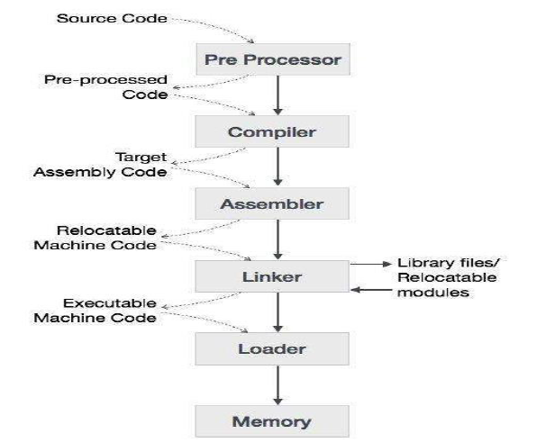
Translation tools-Pre-processors, Interpreters, Compilers and Linkers

Slide 6
Translation tools-Pre-processors, Interpreters, Compilers and Linkers
Preprocessor : A preprocessor, generally considered as a part of compiler, is a tool that produces input for compilers. It deals with macro-processing, augmentation, file inclusion, language extension, etc.
Interpreter & Compiler: An interpreter, like a compiler, translates high-level language into low-level machine language. The difference lies in the way they read the source code or input. A compiler reads the whole source code at once, creates tokens, checks semantics, generates intermediate code, executes the whole program and may involve many passes. In contrast, an interpreter reads a statement from the input, converts it to an intermediate code, executes it, then takes the next statement in sequence. If an error occurs, an interpreter stops execution and reports it. whereas a compiler reads the whole program even if it encounters several errors.

Slide 7
Translation tools-Pre-processors, Interpreters, Compilers and Linkers
Assembler : An assembler translates assembly language programs into machine code. The output of an assembler is called an object file, which contains a combination of machine instructions as well as the data required to place these instructions in memory.
Linker : Linker is a computer program that links and merges various object files together in order to make an executable file. All these files might have been compiled by separate assemblers. The major task of a linker is to search and locate referenced module/routines in a program and to determine the memory location where these codes will be loaded, making the program instruction to have absolute references.
Loader : Loader is a part of operating system and is responsible for loading executable files into memory and execute them. It calculates the size of a program (instructions and data) and creates memory space for it. It initializes various registers to initiate execution.

Slide 8
Cross-compiler : A compiler that runs on platform (A) and is capable of generating executable code for platform (B) is called a cross-compiler.
Source-to-source Compiler : A compiler that takes the source code of one programming language and translates it into the source code of another programming language is called a source-to-source compiler.

Slide 9
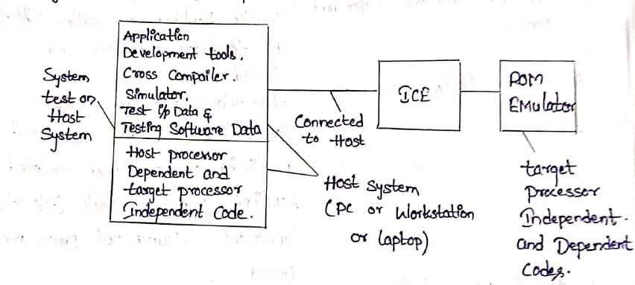
Testing on Host Machine

Slide 10
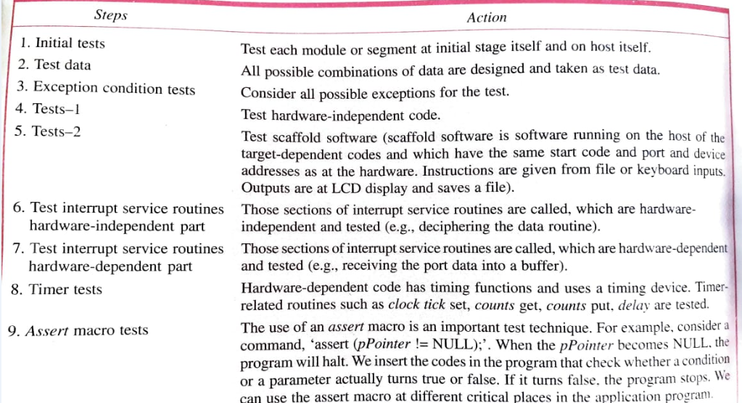
Testing Steps at Host Machine

Slide 11
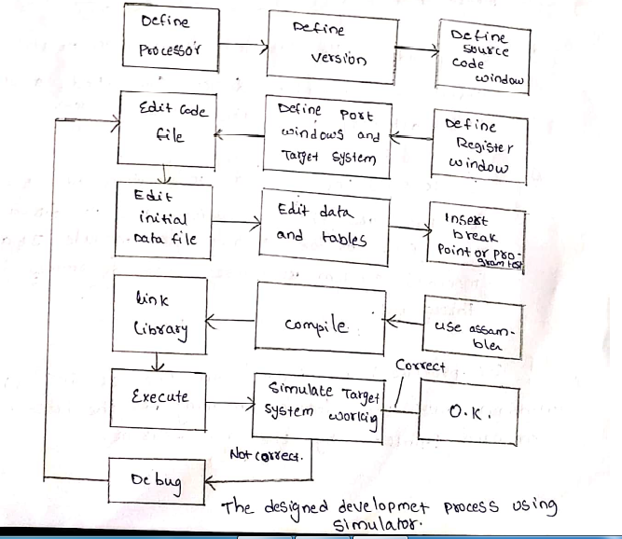
Simulators

Slide 12
Laboratory Tools
Hardware Diagnostic Laboratory Tools:
1. Volt-Ohm meter
2. LED test
3. Logic Probe
4.Logic Analyzer
5.Bit Rate Meter
6.ICE

Slide 13
Quality assurance
System testing and quality assurance come to aid for checking the system. It includes −
Product level quality (Testing)
Process level quality.
The following stages are involved in testing −
Test Strategy
Test Plan
Test Case Design
Test Procedures
Test Result Documentation

Slide 14
Types of Testing
Unit Testing
Integration Testing
Functional Testing
1.Positive Functional Testing
2.Negative Functional Testing

Slide 15
Quality Assurance
Levels of Quality Assurance
Level 1 − Code Walk-through
Level 2 − Compilation and Linking
Level 3 − Routine Running
Level 4 − Performance test

Slide 16
Assignment-2
Integration of Hardware and Firmware
ICE
Embedded Software development process and tools.
Debugging Tools

